Slide 1

Topic: Linear Regression
Group 1
Deepesh Kumar Verma
Abhivrudhi Navaliger
Kanchan Seervi
Senugala Kavya Sree
Kajale Atharva Tushar
Chinchawade Abhishek Madhav

Slide 2

To Predict :
Business Objective: A combined-cycle power plant comprises gas turbines, steam turbines, and heat recovery steam generators. In this type of plant, the electricity is generated by gas and steam turbines combined in one cycle. Then, it is transferred from one turbine to another. We have to model the energy generated as a function of exhaust vacuum and ambient variables and use that model to improve the plant's performance.
Data Set Details : This is a project where the variable to be predicted is energy production The data file contains 9568 observations with five variables collected from a combined cycle power plant over six years when the power plant was set to work with a full load.
Energy Production

Slide 3
Purpose :
To understand and analyze the relationship between different variables and energy production. Using regression analysis techniques, the project aims to identify the factors that have a significant impact on energy production and develop a predictive model. This model can then be used to forecast energy production levels based on the identified variables. The purpose is to provide insights into the factors influencing energy production, optimize energy production processes, and make informed decisions for efficient resource allocation and energy management.
Key Attributes :
Data collection
Variable collection
Exploratory Data Analysis
Regression Analysis
Model deployment

Slide 4
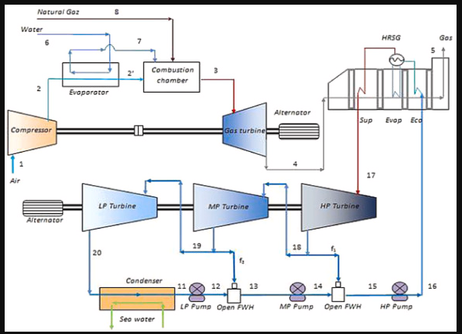

COMBINED CYCLE POWER PLANT
f
rch

Slide 5
Exploratory Data Analysis (EDA) :

Slide 6
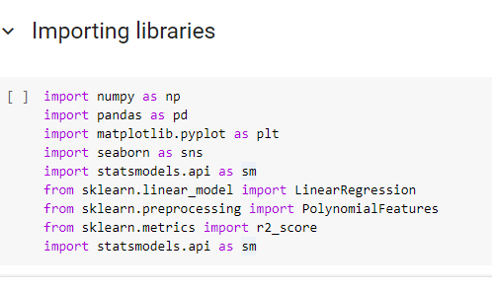

Slide 7
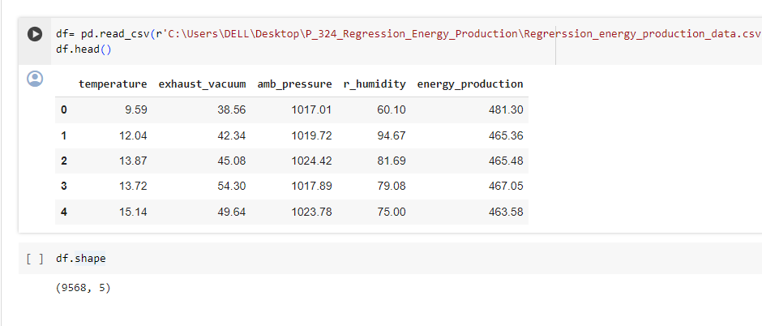
LOADING THE DATASET
The dataset consists of 9568 rows and 5 columns

Slide 8
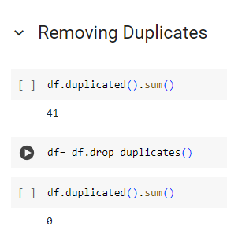

Slide 9
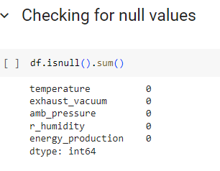
HOW TO CHECK THE NULL VALUES:
AS WE CAN SEE
THERE ARE NO
NULL VALUES
PRESENT
WE CAN FURTHER PROCEED..........

Slide 10
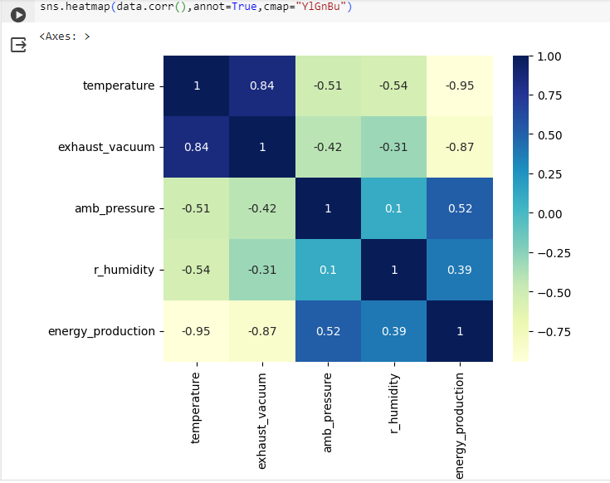
Figure shows the Pearson correlation matrix for CCPP input and output attributes after preprocessing. The Pearson correlation coefficient provides an indication of the level of gradual shift of independent parameters in order to accurately examine the influential aspects of the data. The negative value of coefficients shows the inverse correlation between the variables, whereas the positive value suggests a positive correlation. If the value of the coefficient is 0, it means both the variables are uncorrelated. It can be observed from Figure that input attributes AT and V are negatively correlated to the output PE. Whereas AP and RH have a positive correlation with PE. There is a strong positive correlation between AT and V, and both the input attributes have a negative correlation with AP and RH, respectively.

Slide 11
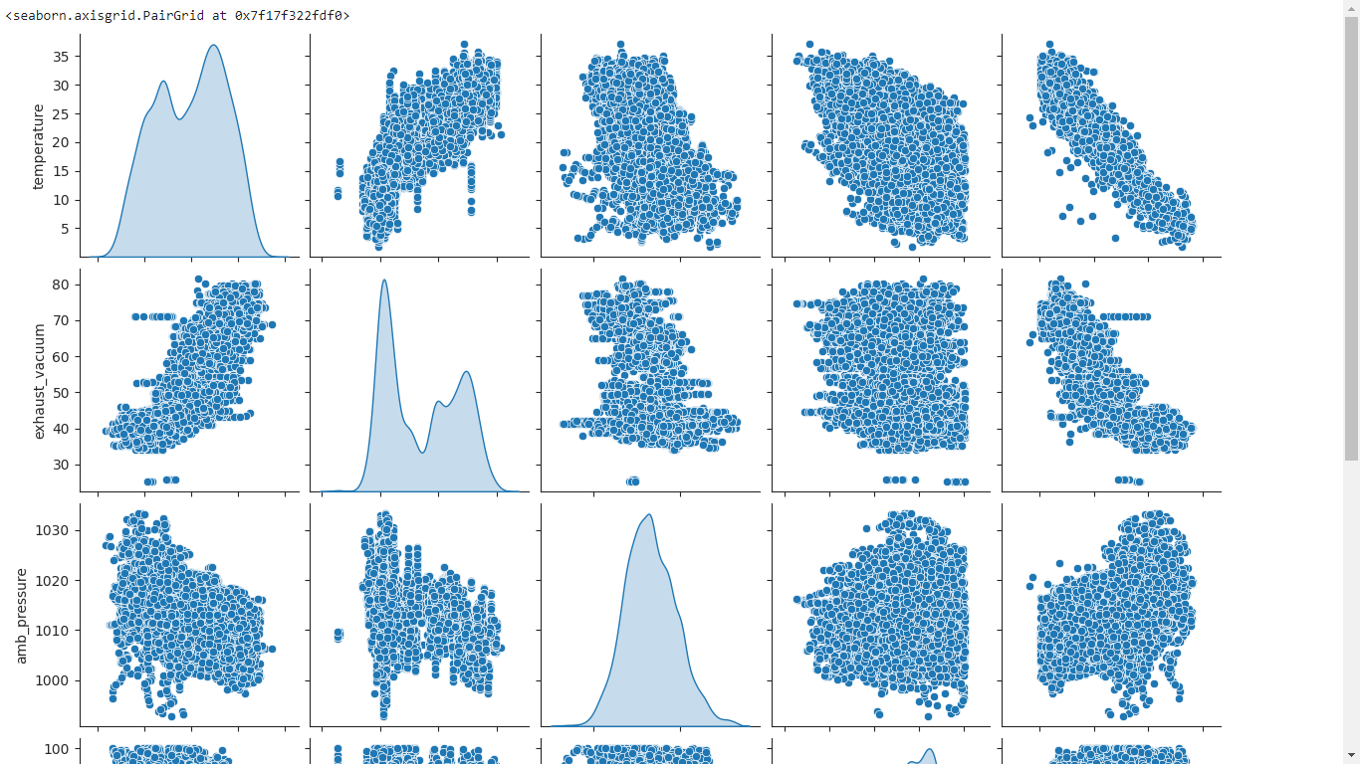
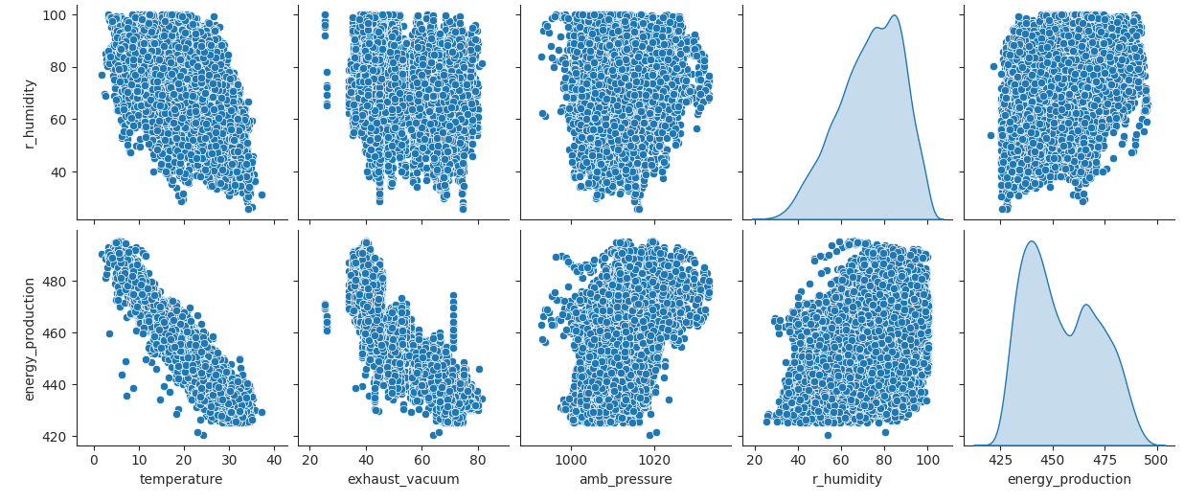
P
A
I
R
P
L
O
T
S

Slide 12
WHY SHOULD WE REMOVE OUTLIERS?
Although outliers are common in datasets,
not many know how to deal with the
presence of such observations. It is usually
practical to remove them since they can
skew the results of data analyses and
hamper model performance

Slide 13
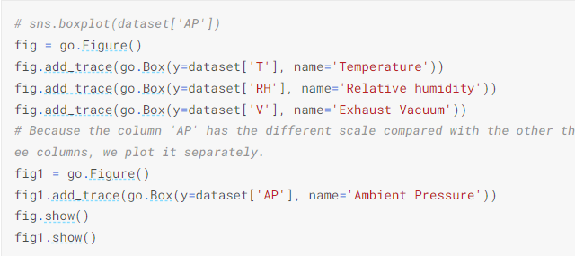
VISUALIZING BOX PLOTS OF CCPP :

Slide 14
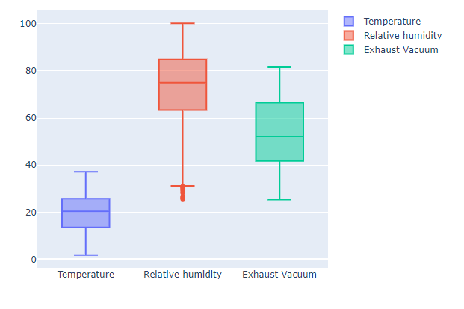
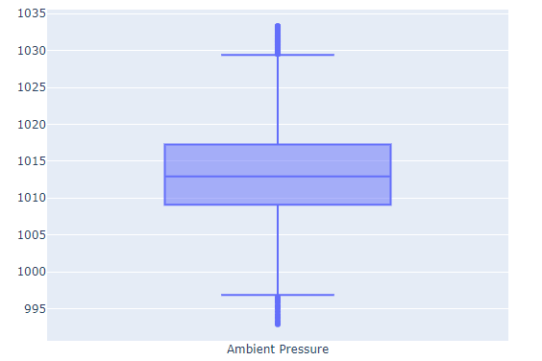
BOXPLOTS :
We can see that
r_humidity and
Exhaust_vacuum
have the outliers
and we need to
remove them

Slide 15
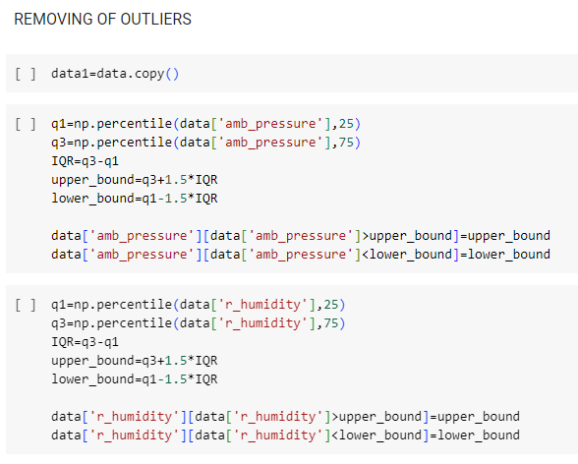

Slide 16
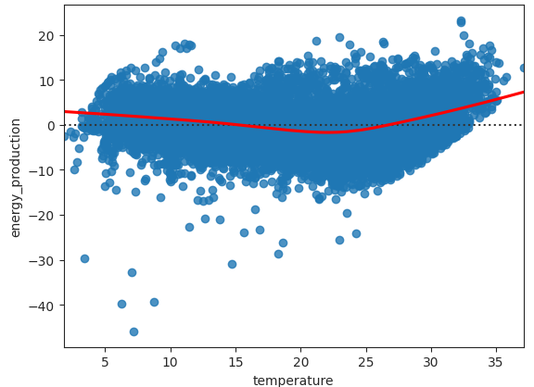
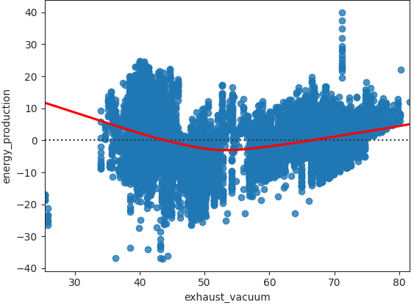
RESIDUAL PLOTS
Residual Plot: A residual plot is a scatterplot that displays the residuals on the vertical axis and the independent variable on the horizontal axis. Residual plots help us to determine whether a linear model is appropriate in modeling the given data.

Slide 17
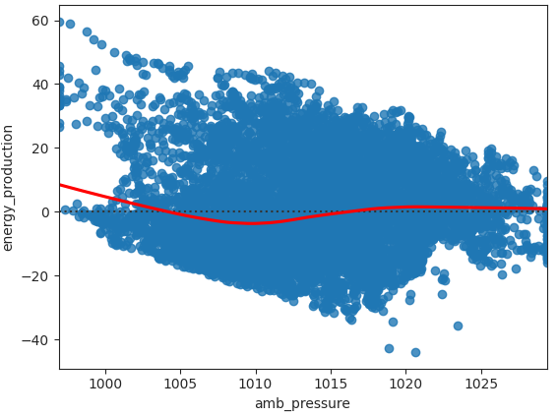
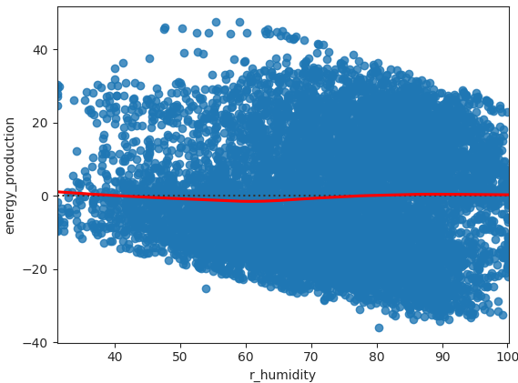

Slide 18
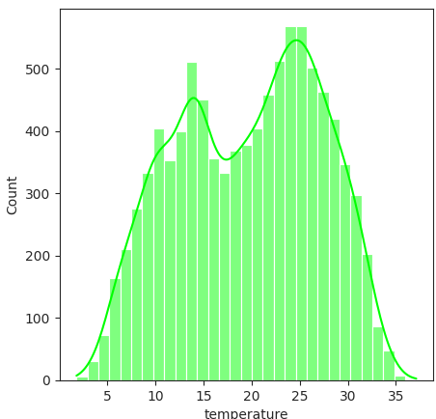
A Histogram represents data provided
in the form of some groups.
It is an accurate method for the
graphical representation of
numerical data distribution.
It is a type of bar plot where the
X-axis represents the bin ranges
while the Y-axis gives
information about frequency.
HISTOGRAMS
BI MODAL DISTRIBUTION

Slide 19
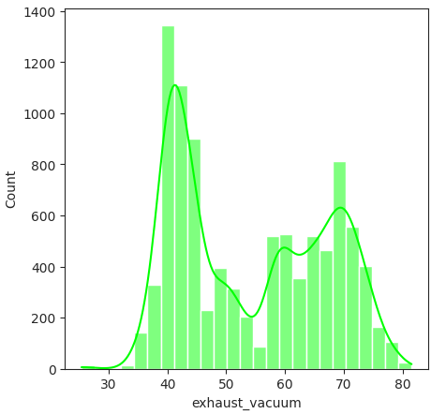
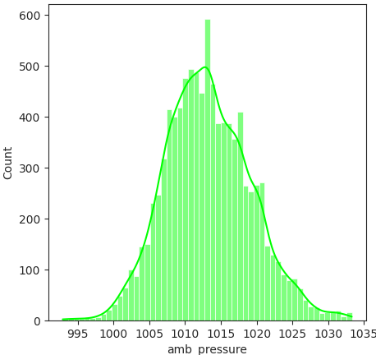
Normal distribution
Uneven distribution

Slide 20
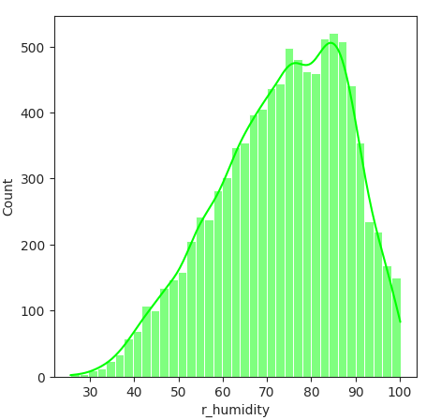
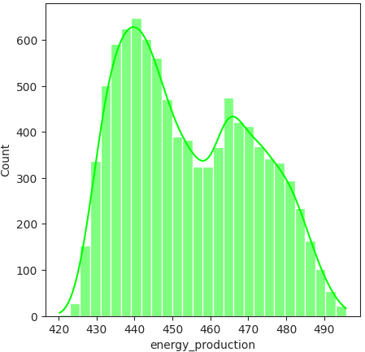
Bi modal distribution
Left skewed distribution

Slide 21
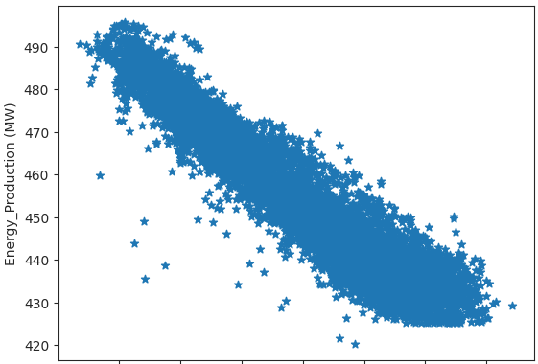
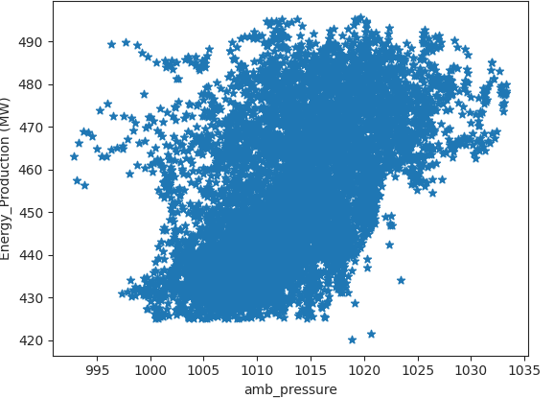
SCATTER PLOTS: Scatter plots are used to observe relationships between variables.
temperature

Slide 22
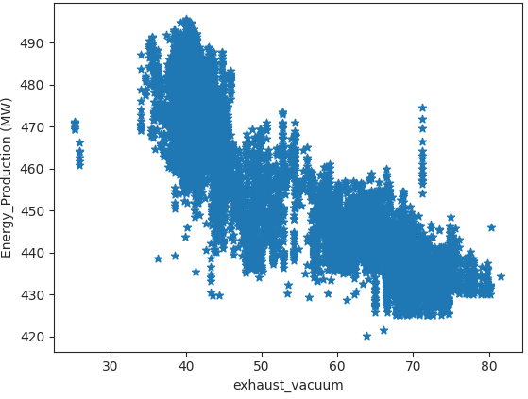
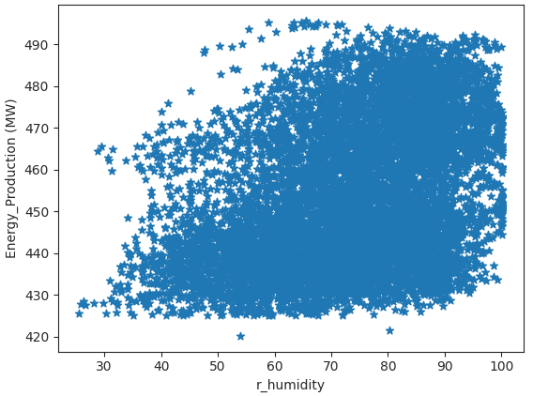

Slide 23
MODEL BUILDING :

Slide 24
Model Building Approaches
Random Forest
Linear Regression
Support Vector Regression
Gradient Boosting Regressor
LightGBM Regressor
K-Nearest Neighbor Regressor
Decision Tree Regressor

Slide 25
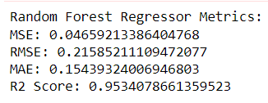
1.Random Forest

Slide 26
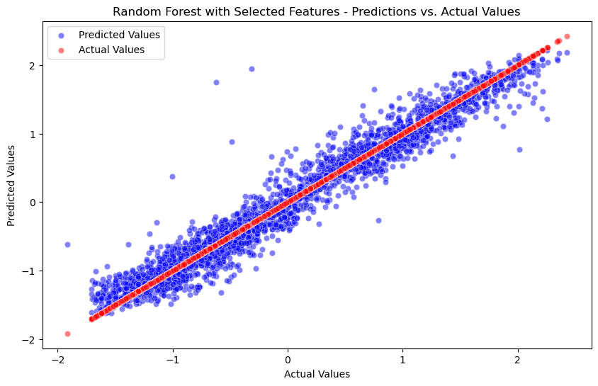
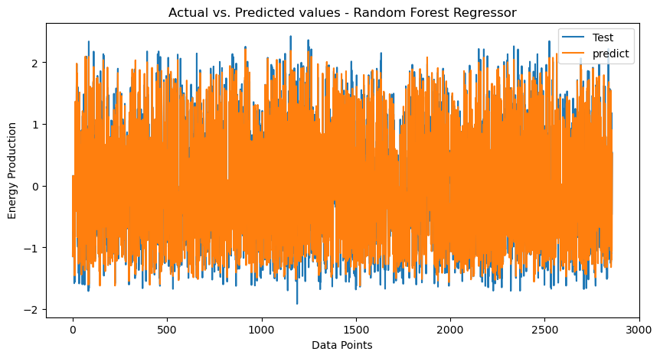

Slide 27
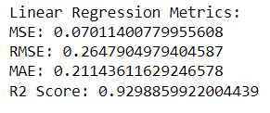
2. Linear Regressor

Slide 28
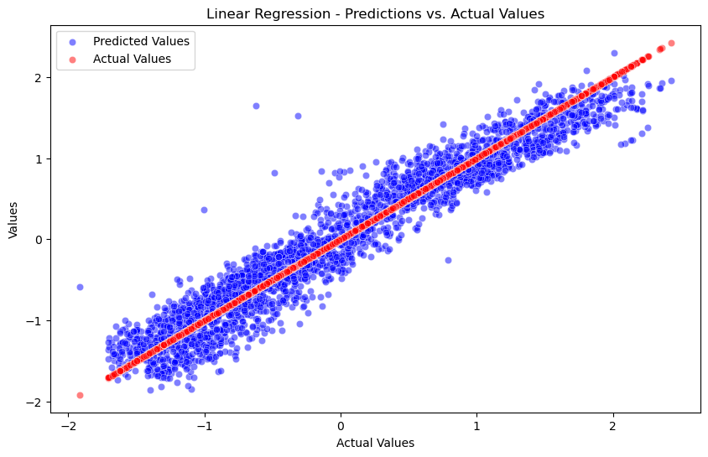
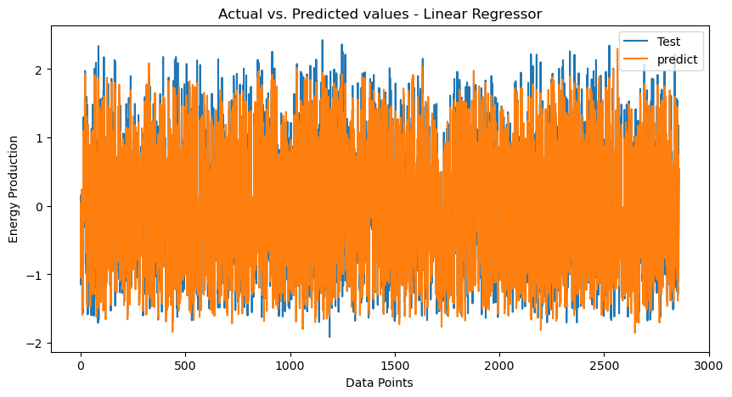

Slide 29
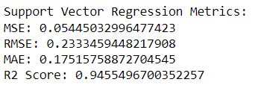
3. Support Vector Regressor

Slide 30
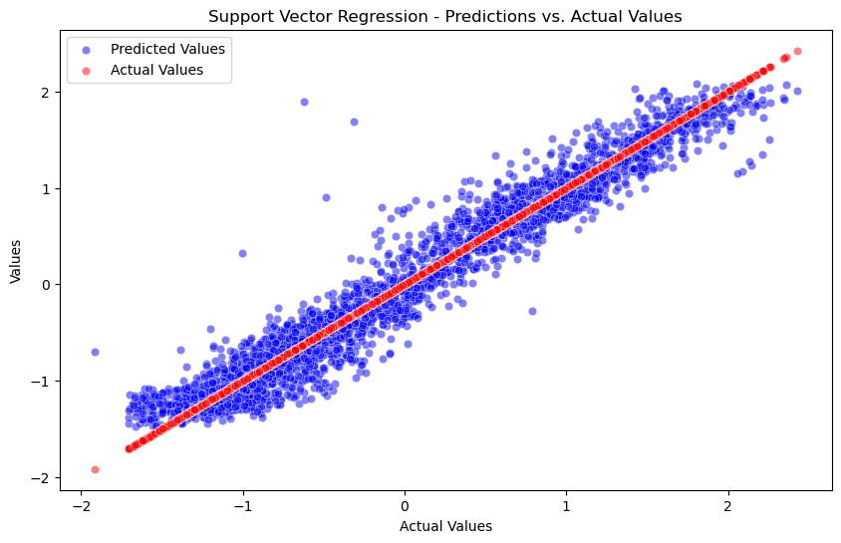
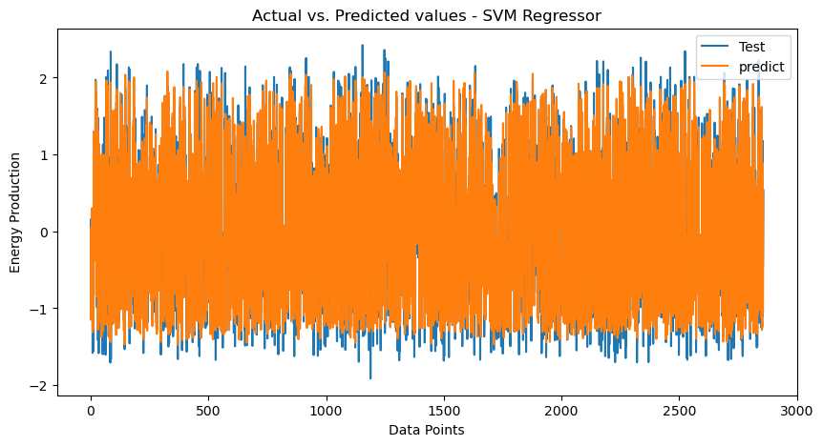

Slide 31
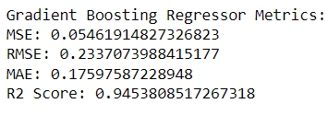
4. Gradient Boosting Regressor

Slide 32
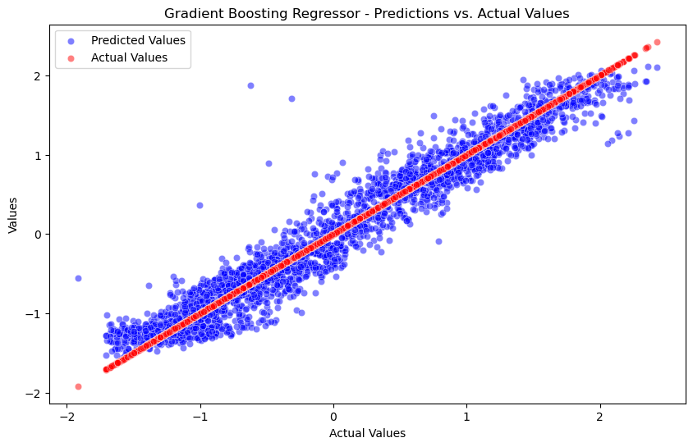
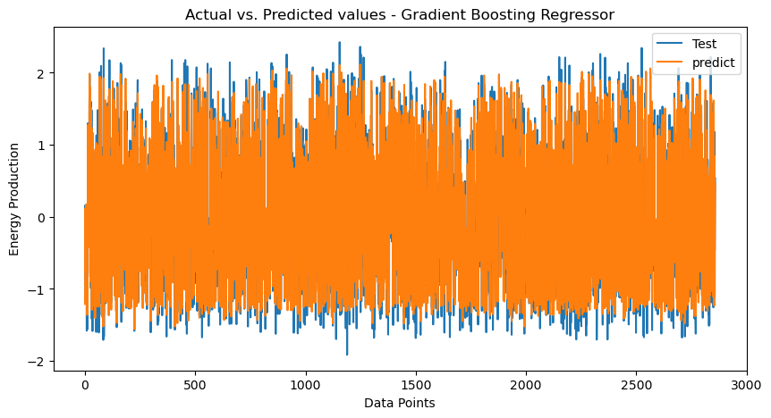

Slide 33
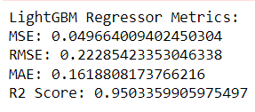
5. LightGBM Regressor

Slide 34
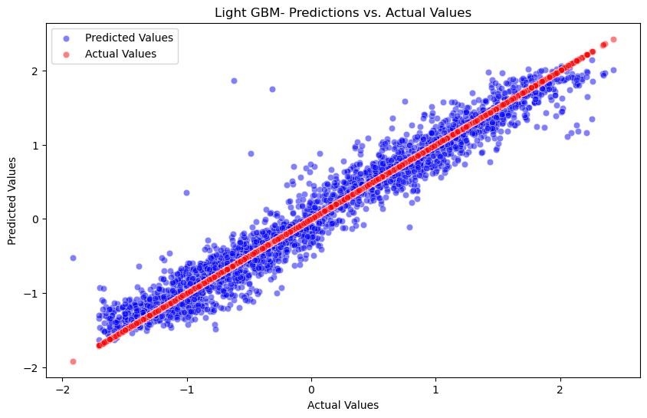
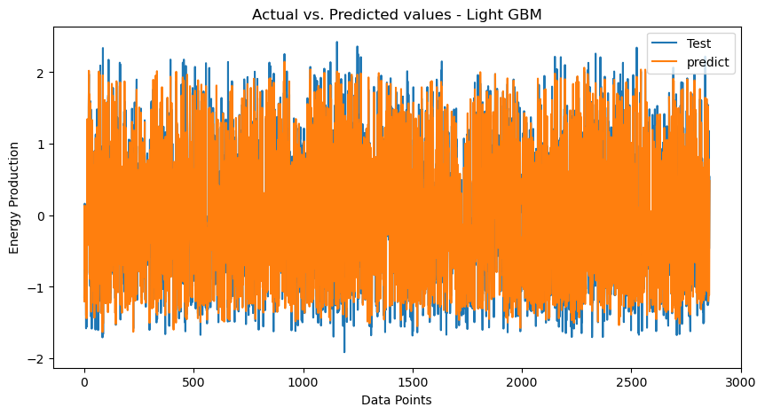

Slide 35
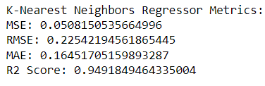
6. K-Nearest Neighbour Regressor

Slide 36
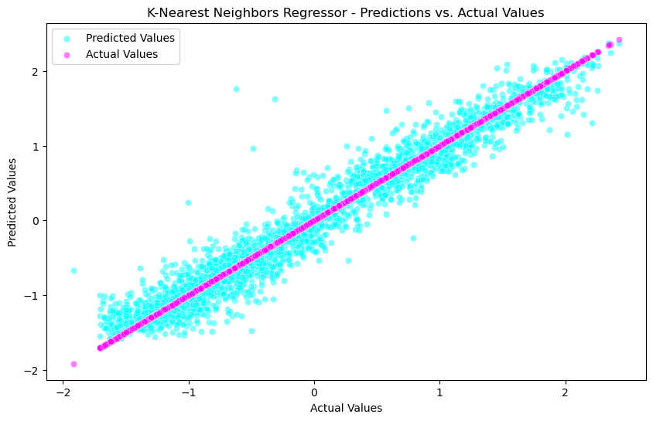
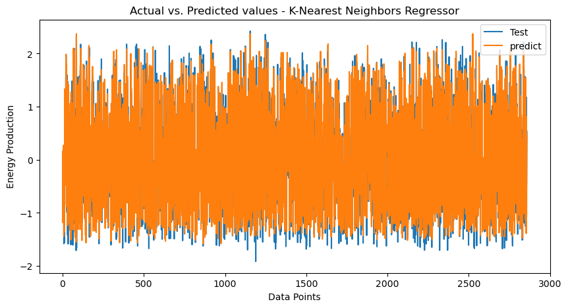

Slide 37
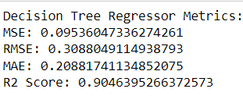
7. Decision Tree Regressor

Slide 38
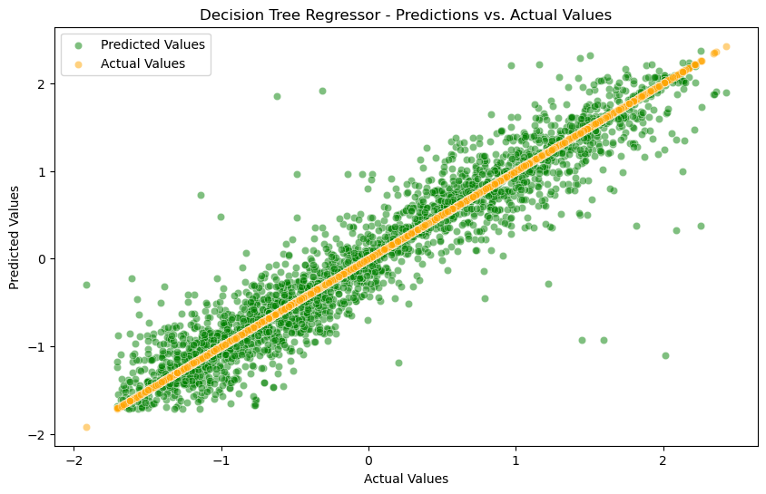
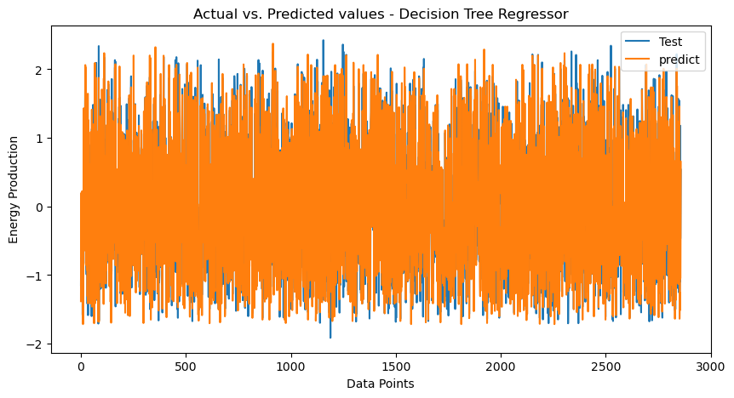

Slide 39
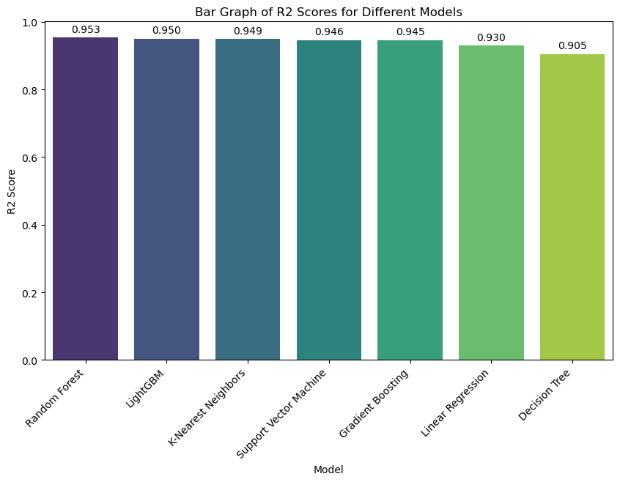
Comparison of all R2-Scores

Slide 40
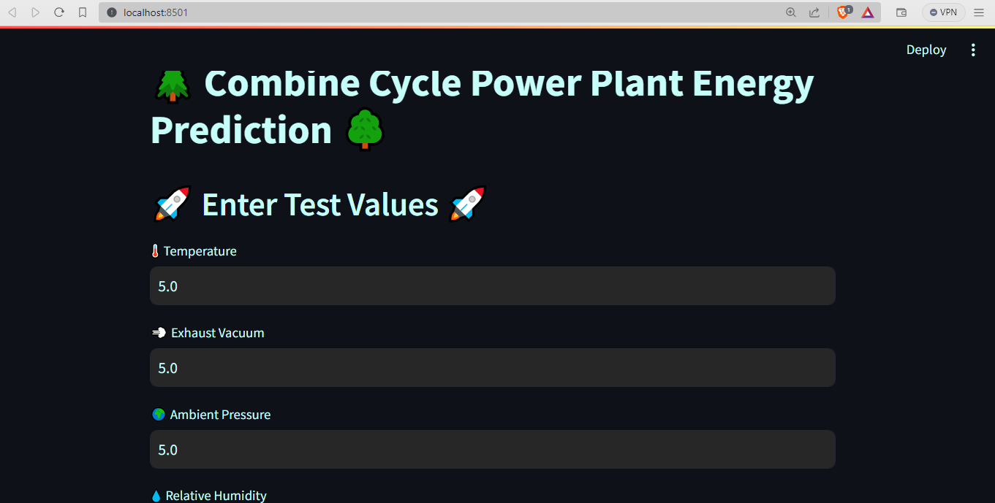
DEPLOYMENT

Slide 41
Challenges Faced:
Model Loading and Path Consistency:
- Ensuring seamless model loading across different environments and avoiding hardcoded absolute paths presented an initial challenge.
How We Overcame the Challenges:
Dynamic Model Loading:
- Adopting a dynamic approach by using relative paths and the `os` module, ensuring the model file is accessible regardless of deployment location.

Slide 42

THANKYOU

